Slide 1
Matthew Livingston
Team 10
Ady (Ye Thiha Aung)
Yvan Burrie
Anthony Vincin
Stephen Ohl

Slide 2
Let us cover our workflow.
Let us reflect on what we did.
Let us suggest any improvements.
Notes:
The purpose of this presentation is to not only cover our workflow in the construction of our website but to also reflect upon what we did and to also suggest what we could have done to improve everything.
2

Slide 3


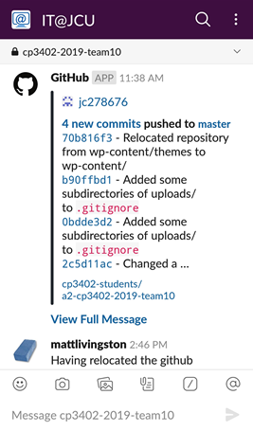

Communication
Slack
Slack + Github Integration
Meetings
Notes:
Slack and Github integration.
3

Slide 4







Technologies & Services
Notes:
4

Slide 5
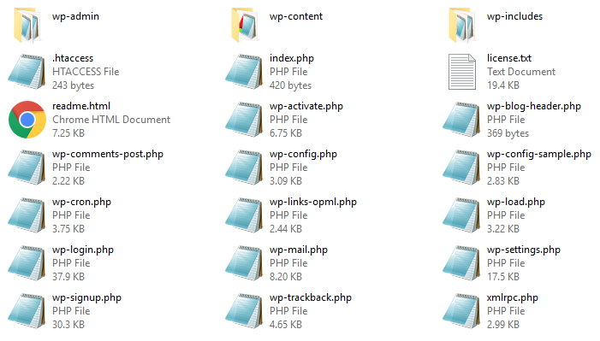


Repo Folder Layout

Slide 6

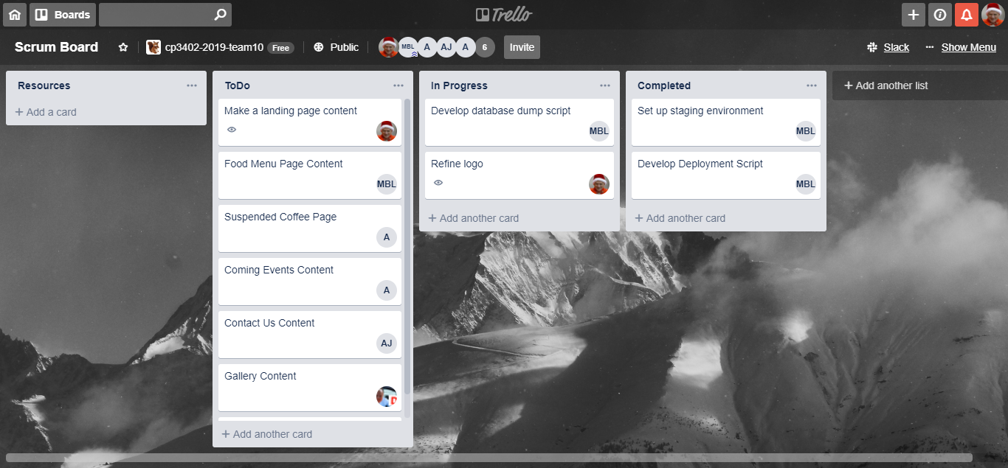
Project Management
(old method)
Notes:
Trello was a single Kanban project board.
Trello was too distant to our communication and collaboration means.
6

Slide 7
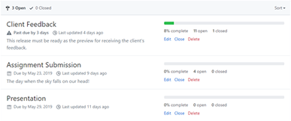
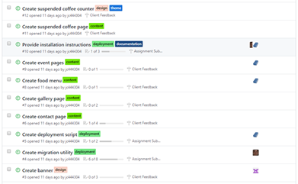
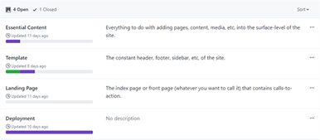
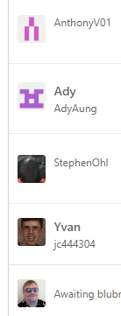

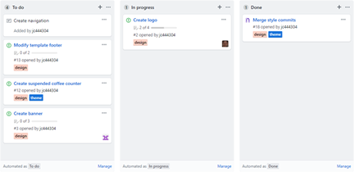
Github Project Management
Milestones
Issues
Projects
Assignees
Labels
Kanban + Cards

Slide 8
Security

Slide 9


Collaboration & Deployment
Local Devs
Master
Production
1
Branch
Publish
Staging
Staging
Push & Pull
(inc. DB)
2
Webhook
3
Github
Server

Slide 10

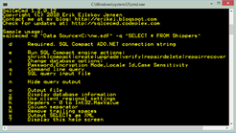


Database Migration
(old method)
SQL
Dump
File
Interface (1)
Interface (2)
(Database imports & exports may go in either direction)
Notes:
Our initial means of exchanging databases.
We needed to manually export and import SQL files using PhpMyAdmin (or MySQL commands).
This method was unsystematic and timely.
10

Slide 11

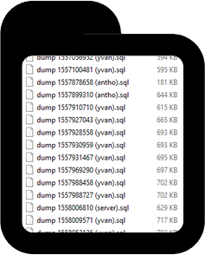
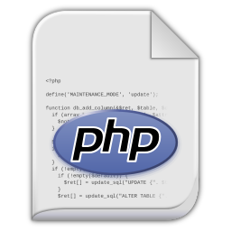
Database Migration
(new strategy)
Notes:
We instead used a PHP utility that handles database importation or exportion.
11

Slide 12

Database Migration
(after-thoughts)
Problem?
SQL dump file is a monolithic approach that can disrupt data integrity since .
Solution?
Use rollback approach such as version-controlled queries.
Notes:
12

Slide 13

Thanks!

